Slide 1

Group 8 – Project Work
Crime Along with Drug Abuse Data State Wise
Aniket Kumar
Anusha Papineni
Shafiya Askari

Slide 2

DRUGS CRIME AND ECONOMY: IS THERE A LINK ?

Slide 3
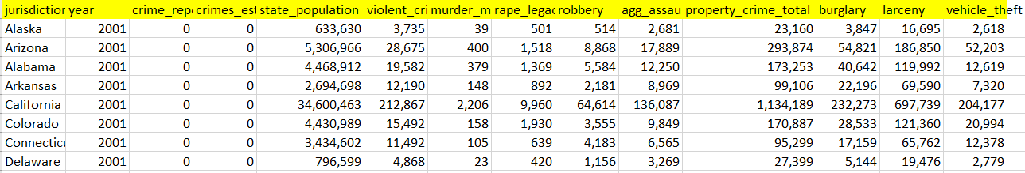
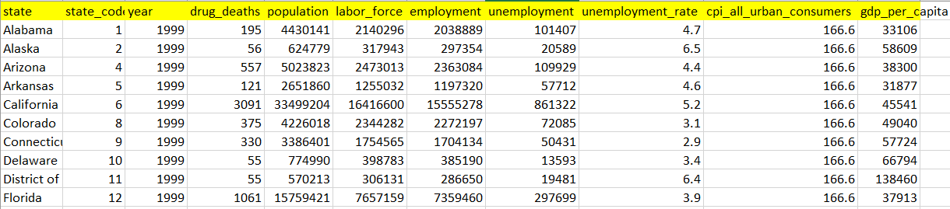
Objectives
Drug Abuse Data along with GDP state wise from 1999 – 2014
Crime based data for each state from 2001 – 2015
Relate GDP for each state along with the Drugs and crime categories in each state

Slide 4
Steps Taken
Data Source:-
Drug Abuse GDP Data – Center for disease and control prevention (CDC)
Crime Categories Data – Uniform Crime Report
Merged the two datasets based on years and state
Then, cleaned the data and exported to csv file

Slide 5
Data Cleaning
Strip off white spaces
Drop Duplicate Columns
Change Data Types
Create Calculated Columns

Slide 6
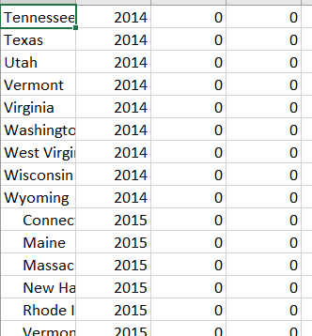

Strip off white spaces
white spaces are found in the state column in both the data frames
Stripped off white spaces

Slide 7
Merged Data
Merged both the data frames on the columns State and year.

Slide 8
Duplicate Columns
The column ‘ population ’ is found in both the datasets with same value.
dropped duplicate columns from the merged data

Slide 9
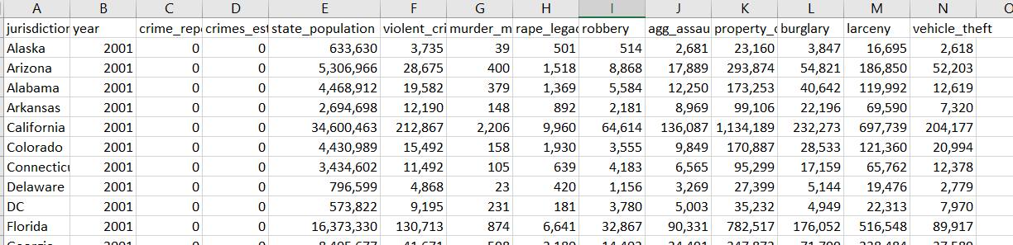
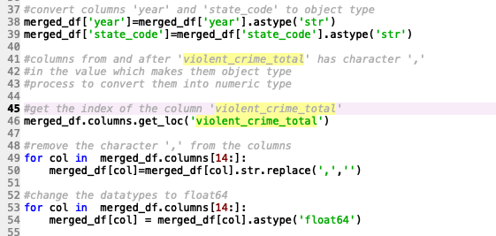
Changing Data Types
We found that few numeric columns were in object data type.
The columns contained comma ‘ , ’ in numerical value
Removed the comma from the column and converted the column to numerical data type for better calculations.

Slide 10
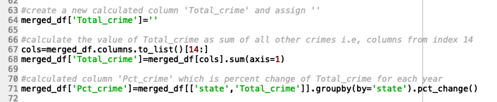
Calculated Columns
Created some calculated columns to give us more insight in the data
Total Crime in each state year wise
Percentage increase and decrease in crime based on year

Slide 11
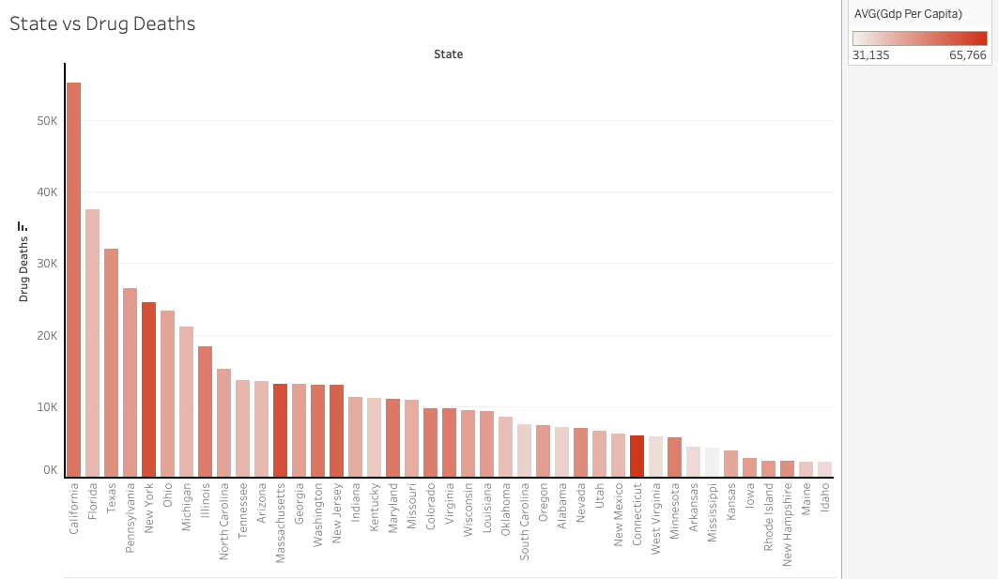
Visualization

Slide 12
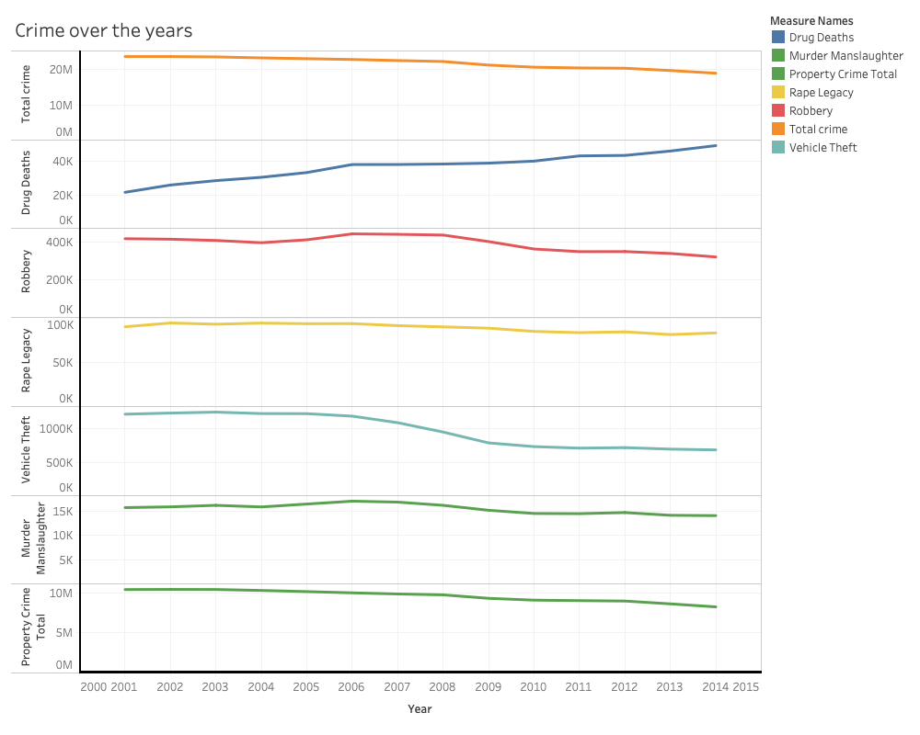

Slide 13
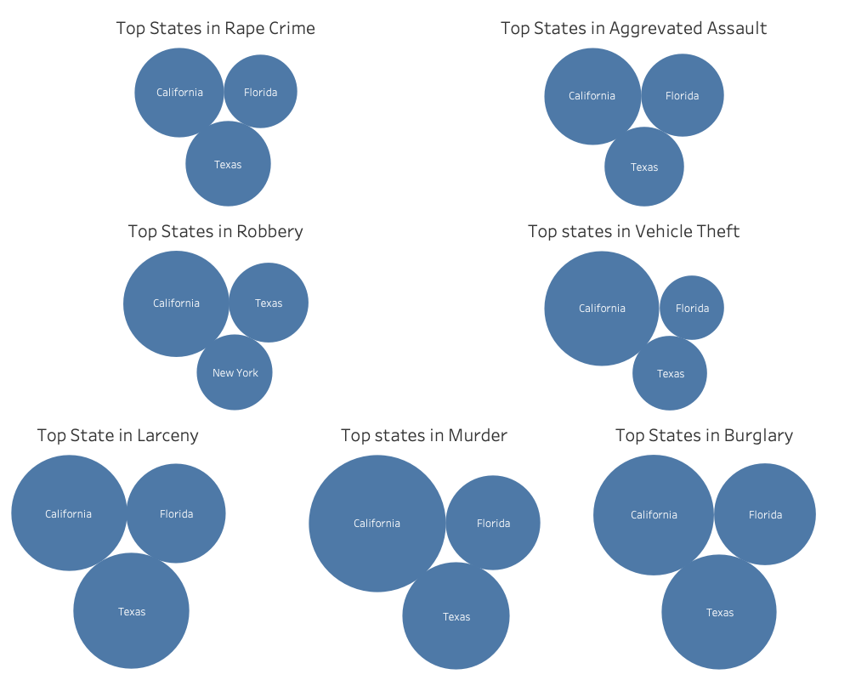

Slide 14
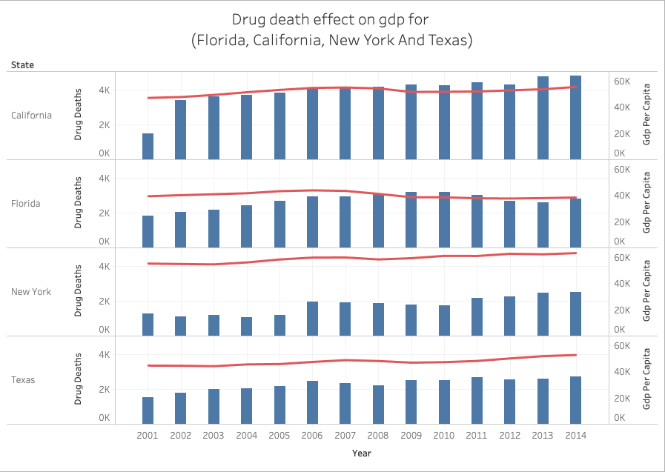

Slide 15
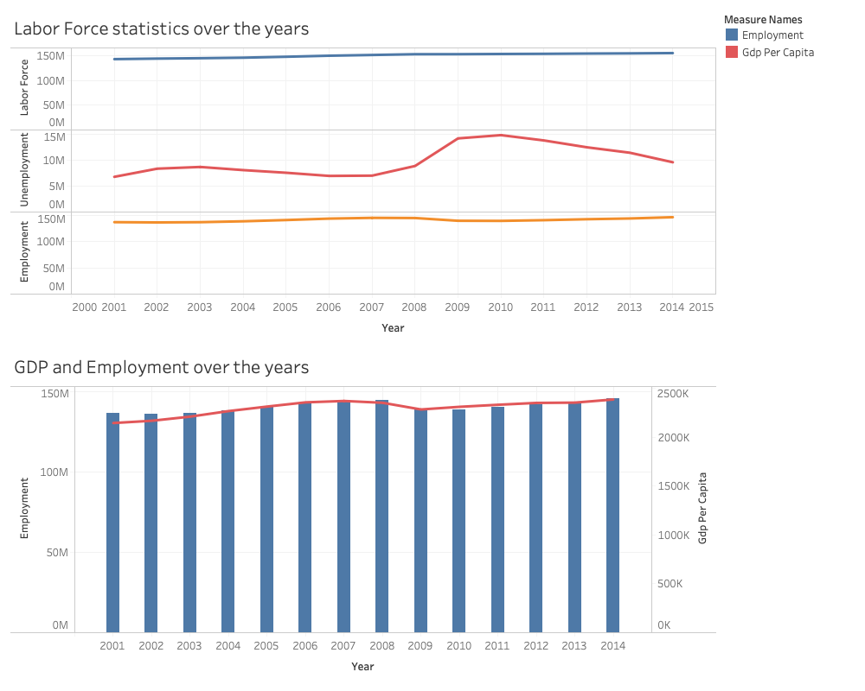

Slide 16
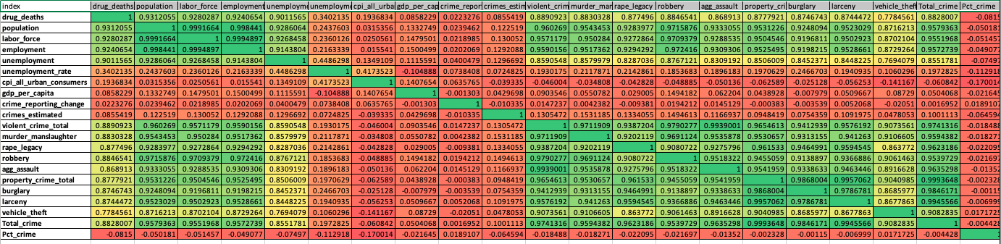

Slide 17
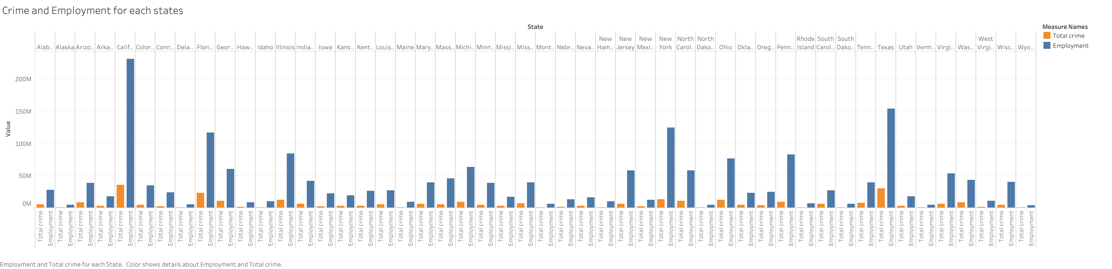

Slide 18
Thank you!

